Slide 1

Search Algorithms
Artificial Intelligence
Faculty of Computing
Universiti Teknologi Malaysia

Slide 2
Formulation
State Space
Problem Formulation
Graph Theory
State Space Mapping

Slide 3
Searching Algorithm in AI
In Artificial Intelligence, Search techniques are universal problem-solving methods.
Rational agents or Problem-solving agents in AI mostly used these search strategies or algorithms to solve a specific problem and provide the best result.
Problem-solving agents are the goal-based agents and use atomic representation.

Slide 4
What do you need to know?
Represent a problem as – A STATE SPACE
Analyze the structure and complexity of problem and search procedures using – GRAPH THEORY
Nodes represent discrete states Example: Different configuration of game board
Path/arcs/links represent action between states Example: Movement in a game

Slide 5
State Space
When states and actions are specified a state space is defined
States + Actions 🡪 State Space
State space consists of a set of states and a set of actions connecting states with each other and can be viewed as state-space graph
Problems can be modelled as a state space
The state space forms a directed network or graph in which the nodes are states and the links between nodes are actions
Can be define as; search for a path from initial state to a goal state
Notes:
https://slideplayer.com/slide/9410231/
https://en.wikipedia.org/wiki/State_space_search

Slide 6
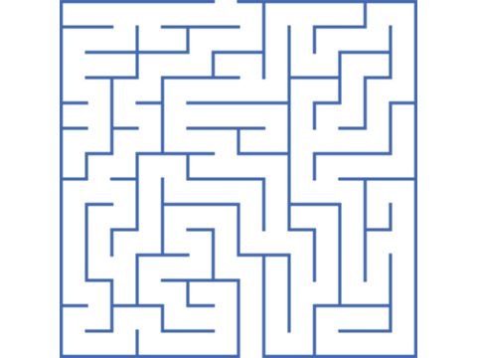
Problem Formulation
Problem formulation is the process of deciding what actions and states to consider, given a goal
Problem formulated by specifying four things:
Initial state
Actions
Goal test
Path cost
Solution: sequence of actions leading from initial state to goal state.
Initial State
Goal State
Notes:
Belum siap lagi

Slide 7
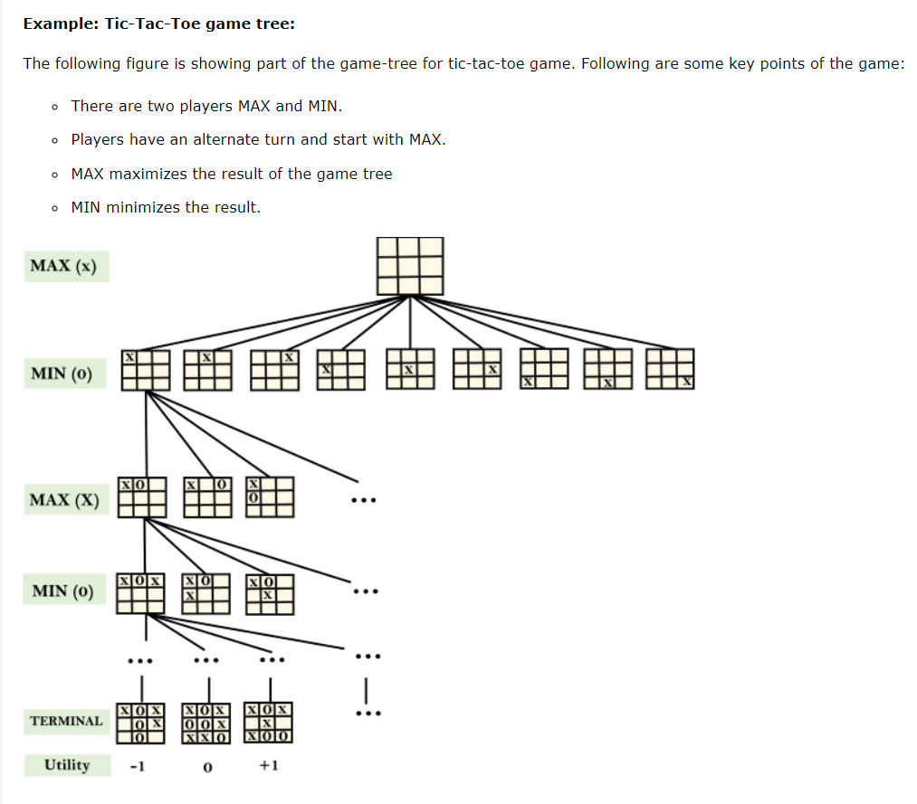
Example of State Space

Slide 8
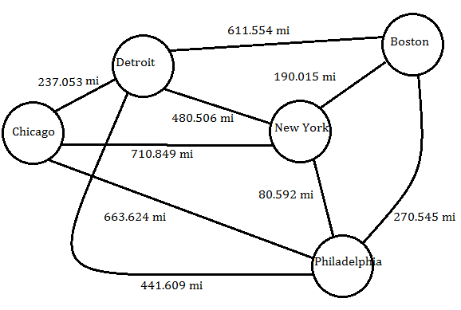
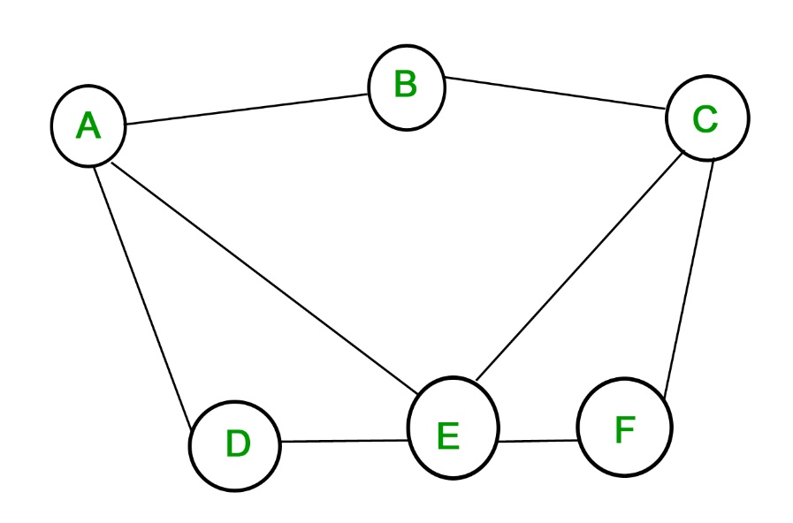
Example of Graph Theory
Node
Arc

Slide 9
Graph Theory: Intro
Tool for reasoning about the structure of objects and relations
Structure of the problem can be VISUALISED more directly.
Invented by Swiss Mathematician Leonhard to solve “Bridges of Konigsberg Problem” (Newman 1965)
Problem: Is there a walk around the city that crosses each bridge exactly once?

Slide 10
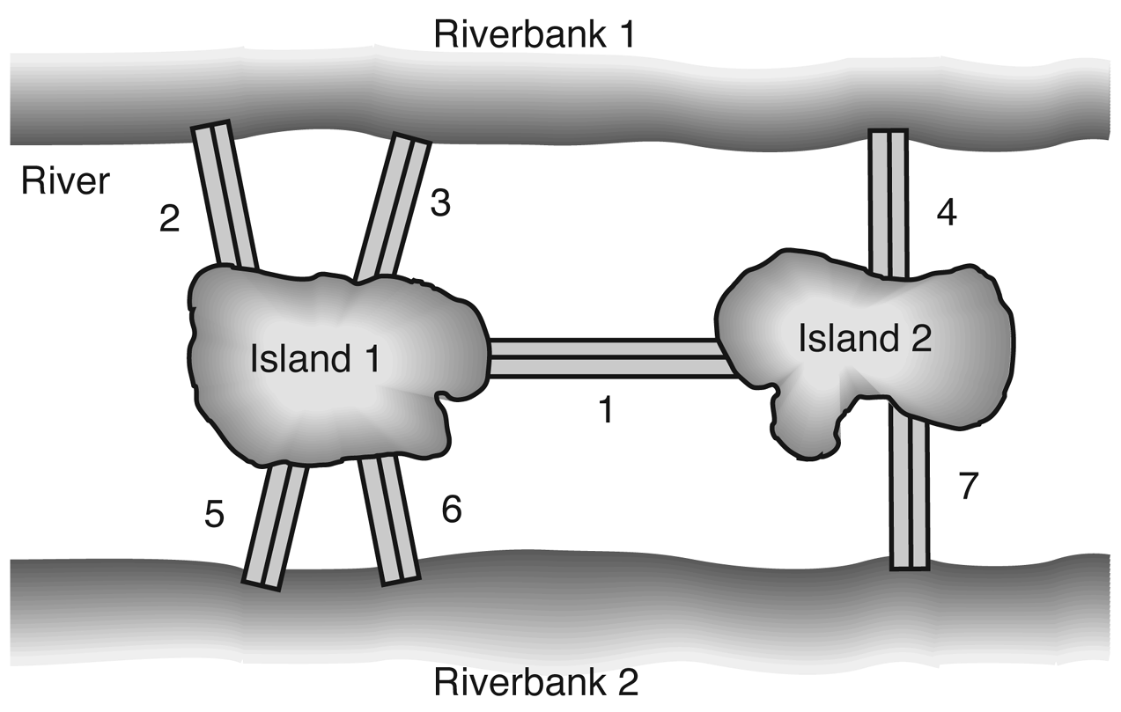
Graph Theory
The city of Königsberg- 2 islands, 2 riverbanks and 7 bridges
Notes:
Exercise,
Relate with predicate
1. Give a predicate to indicate the relation direction between nodes RB and I ?
connect(X,Y,Z)
2.

Slide 11

Represent using Graph Theory
Activity 1.0 (10 mins):
Assumes that 2 islands and 2 riverbanks become the nodes of the graph. Meanwhile 7 bridges become the arcs.
Draw a graph that consist all those nodes and arcs.
Share in the class.
Notes:
Exercise,
Relate with predicate
1. Give a predicate to indicate the relation direction between nodes RB and I ?
connect(X,Y,Z)
2.

Slide 12
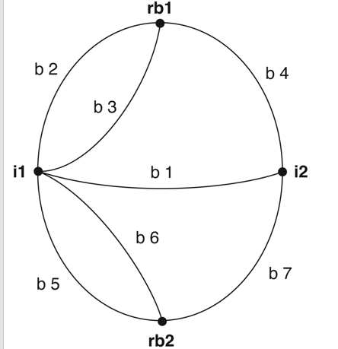
Possible Answer
Notes:
Exercise,
Relate with predicate
1. Give a predicate to indicate the relation direction between nodes RB and I ?
connect(X,Y,Z)
2.

Slide 13
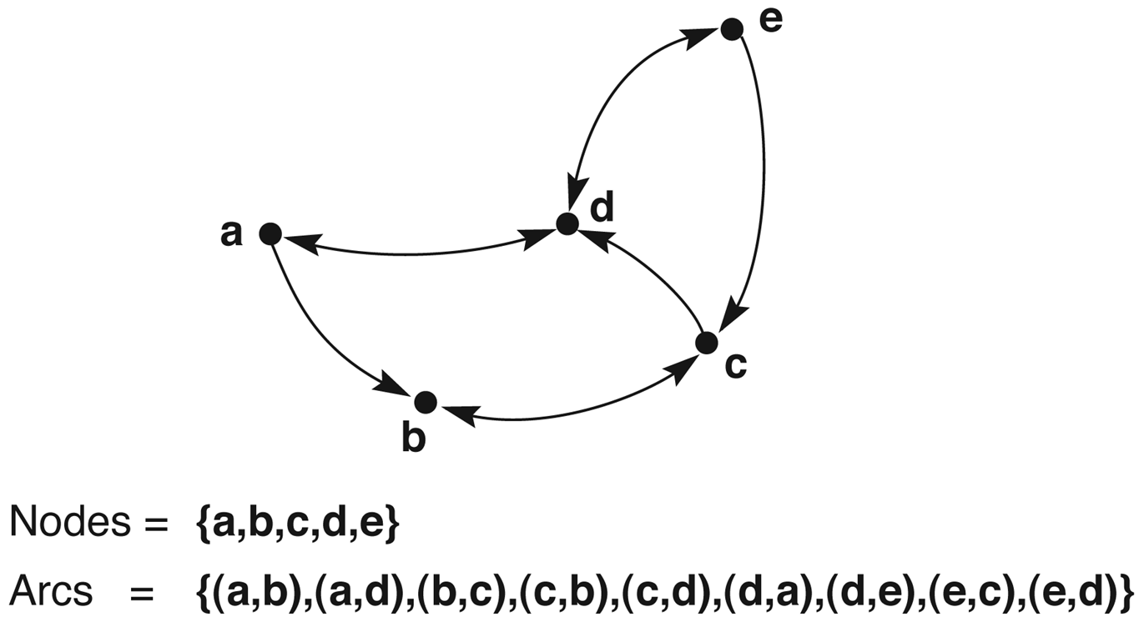
Graph Theory : Structure
a) A labeled directed graph- arrow indicate directions
Nodes
{a, b, c, d, e}
Arcs
{(a,b),(a,d), (b,c),(c,b),(c,d),(d,a),(d,e),(e,c),(e,d)}

Slide 14
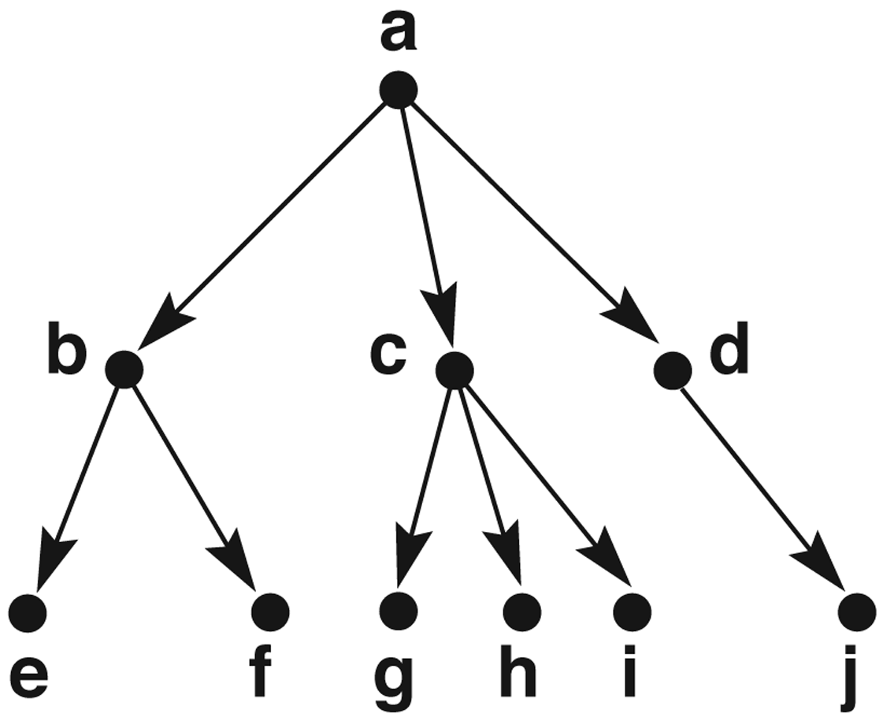
Graph Theory: Structure
b) A rooted tree, exemplifying family relationships(parents, child, sibling)
Path from root to all nodes
Directed graph with arcs having one direction ~no cycle
Example: game players cannot UNDO moves
1
5
Root
Ancestor of nodes g, h and i
2
Parent
4
3
Leaf or tip
child

Slide 15
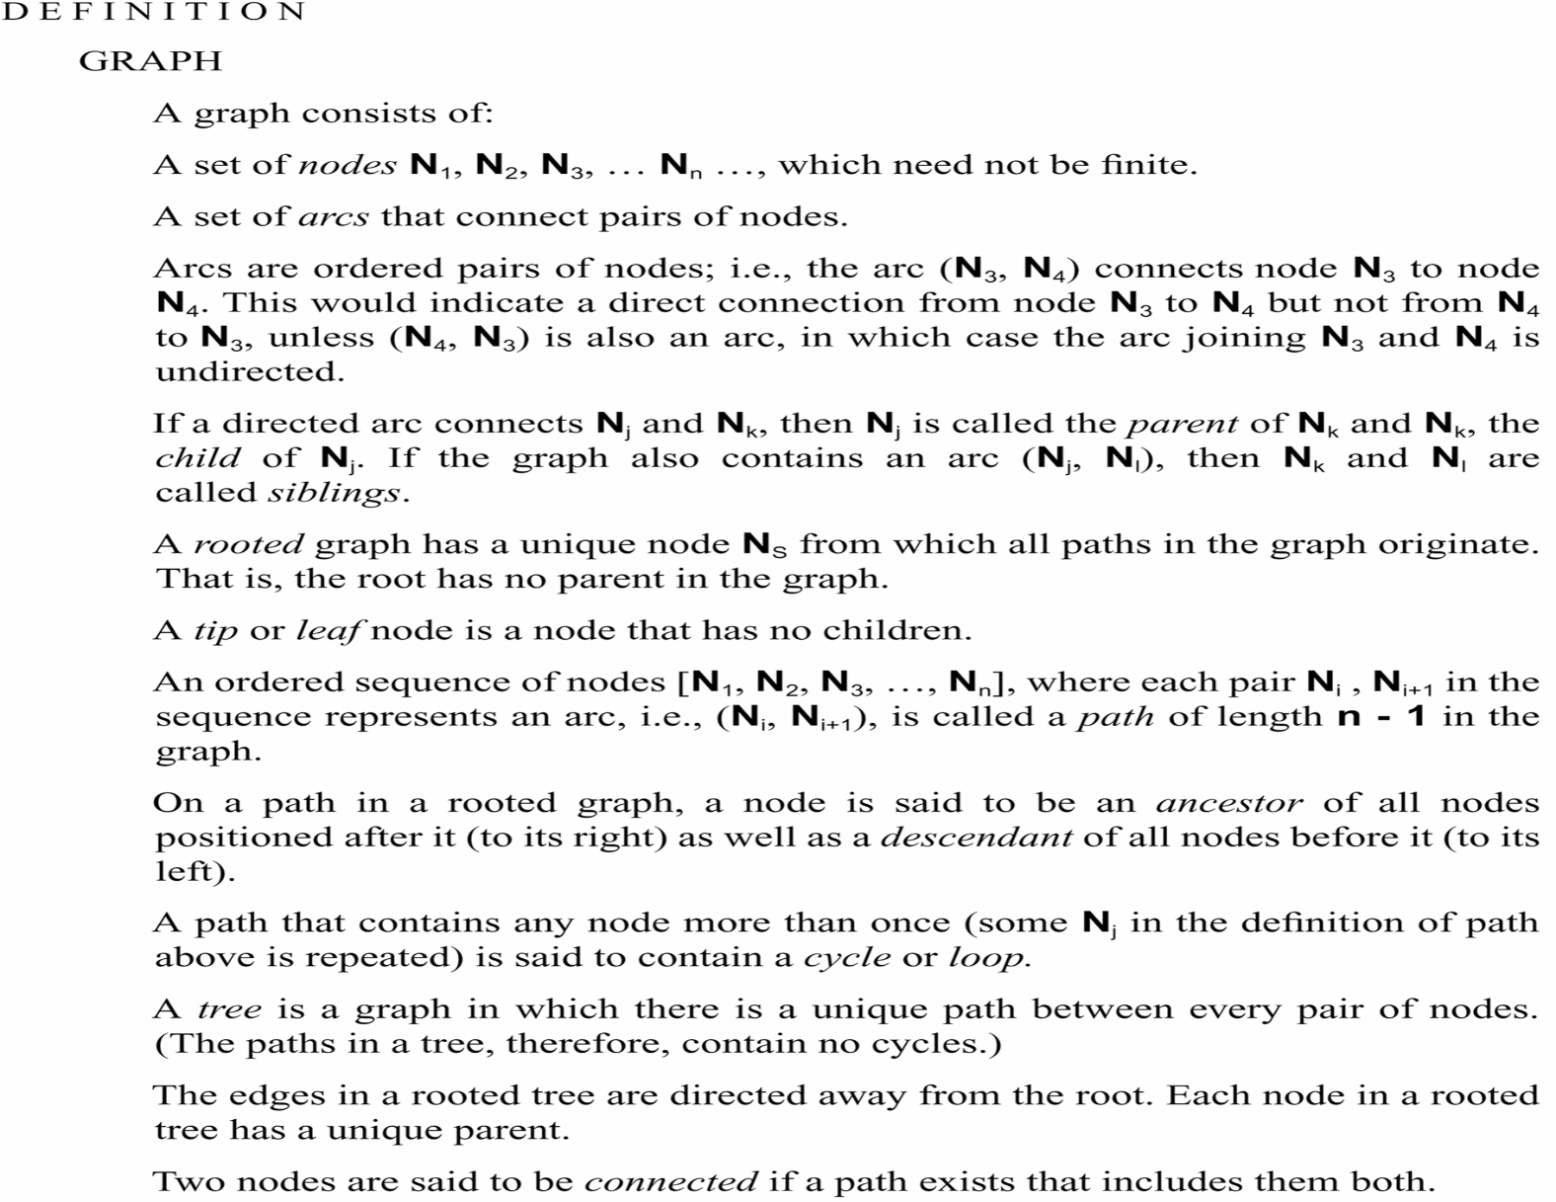
Graph Theory: Definition
Notes:
Belum siap lagi

Slide 16
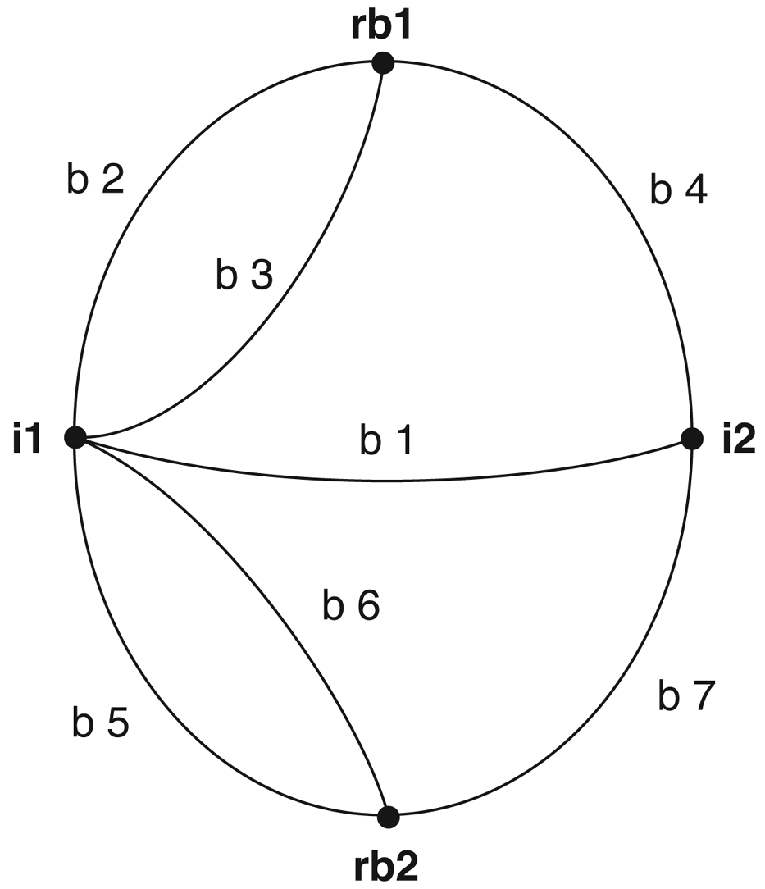
Graph Theory: Using Predicate Logic
Euler Graph Theory: Graph of the Königsberg bridge system.
Activity 2.0 (5 mins):
Based on the given graph of Konigsberg bridge system, two nodes can be connected by an edge. For example, using predicate logic, it can be represented using Connect(i1, i2, b1).
List all possible connections in a form of predicate logic.
Share in the class.
Notes:
Answer:
EULER noted WALK WAS IMPOSSIBLE UNLESS A GRAPH HAS EXACTLY ZERO OR TWO NODES OF ODD DEGREES

Slide 17
Graph Theory: Using Predicate Logic - Answer
Euler Graph Theory: Graph of the Königsberg bridge system.
Represent using predicate calculus:
Connect(i1, i2,b1) Connect(i2,i1,b1)
Connect(rb1, i1,b2)Connect(i1,rb1,b2)
Connect(rb1, i1,b3) Connect(i1,rb1,b3)
Connect(rb1, i2, b4) Connect(i2,rb1, b4)
Connect(rb2,i1,b5) Connect(i1,rb2, b5)
Connect(rb2,i1,b6) Connect(i1,rb2,b6)
Connect(rb2,i2,b7) Connect(i2,rb2, b7)
EULER noted WALK WAS IMPOSSIBLE UNLESS A GRAPH HAS EXACTLY ZERO OR TWO NODES OF ODD DEGREES
Write a prolog rule to indicate a path is allowed in both direction? Advantage? This can reduce the no. of predicates needed.

Slide 18
Graph theory problem
Wolf, sheep and cabbage problem https://www.youtube.com/watch?v=pBT-8gqhHzo
A great video explaining graph theory

Slide 19
Search Algorithm
Search Algorithms
Selection of a Search Strategy
Implementation of Graph Search

Slide 20
Search Algorithm : Taxonomy
Search Algorithm
Uniformed Search/ Blind Search
Informed Search/ Heuristic Search
Breadth-first Search
Best-first Search
Iterative deepening search
Greedy Best-first Search
Uniform-cost Search
Bidirectional Search
A∗ Search
Depth-first Search
Depth-limited Search
Recursive Best-first Search

Slide 21
Search Algorithm : Criteria
Uninformed Search Algorithms |  | Informed Search Algorithms
Uninformed search strategies use only the information available in the problem definition.
No additional information on the goal node other than the one provided in the problem definition
The plans to reach the goal state from the start state differ only by the order and/or length of actions.
Uninformed search is also called Blind search.
Informed search strategies use other domain specific information
The algorithms have information on the goal state

Slide 22
Data Driven & Goal Driven Approach
Selection of a Search Strategy : Intro
State space may be searched in two directions:
From given data of a problem instance towards a goal
Goal From a goal back to the data
Data of a problem
Goal
Goal
Data
Notes:
https://visualgo.net/en/dfsbfs?slide=1

Slide 23
Selection of a Search Strategy
Data-Driven Approach
Also called as data-directed search, forward chaining
The problem solver begins with given facts of the problem and a set of legal moves or rules for changing states.
Search proceeds as follows:-
Applying rules to facts to produce new facts.
New facts are used by rules to produce more new facts.
Process continues until it generates a path that satisfies the goal condition.
Data driven search uses the knowledge and constraints found in the given data of a problem to guide search along lines known to be true

Slide 24
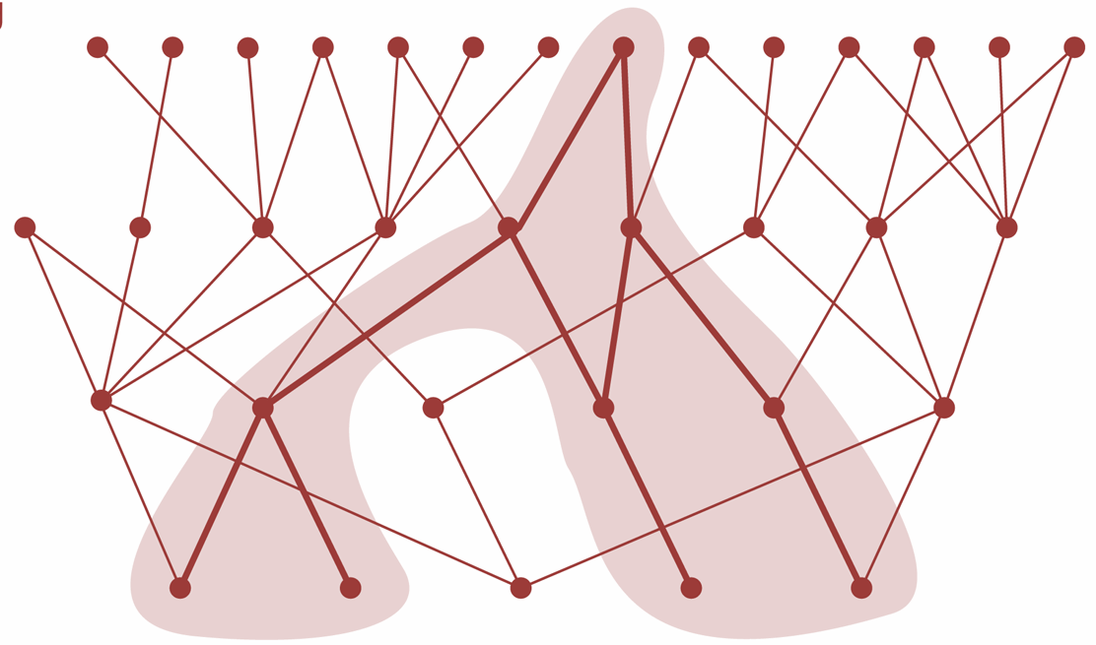
Data-Driven Approach
Selection of a Search Strategy
Goal
Direction of reasoning
Data

Slide 25
Goal-Driven Approach
Selection of a Search Strategy
Also called as goal-directed search, backward chaining
Take the goal that we want to solve and see what rules or legal moves could be used to generate this goal. Also determine what conditions must be true to use them.
These conditions become the new goals or subgoals for the search. Reaching subgoals, determining new subgoals and so on..
Search continues, working backward through successive subgoals until it works back to the facts of the problem.
Goal driven search thus uses knowledge of the desired goal to guide the search through relevant rules and eliminate branches of the space.

Slide 26
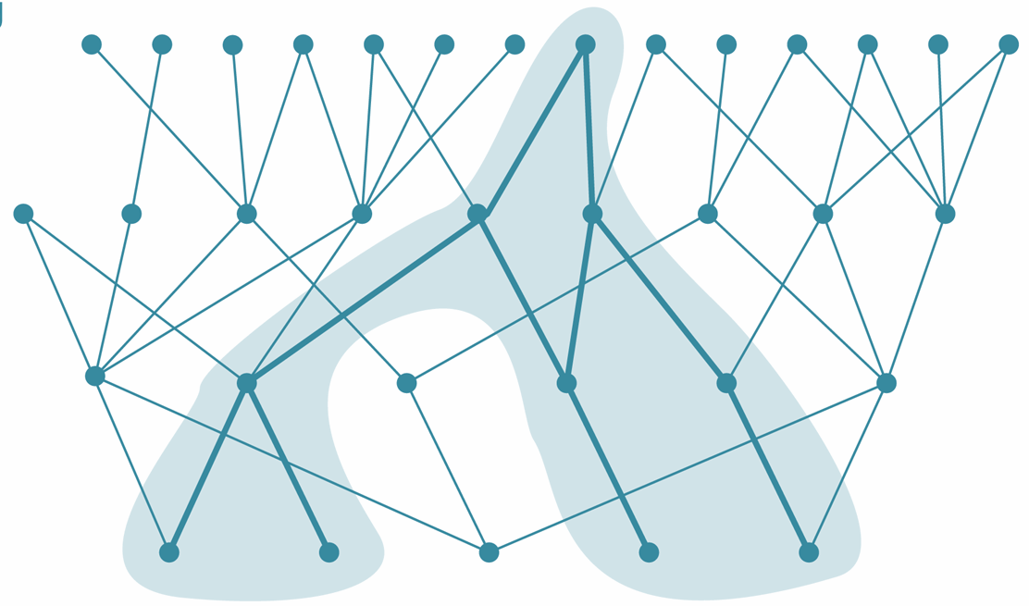
Goal-Driven Approach
Selection of a Search Strategy
Goal
Direction of reasoning
Data

Slide 27
Selection of a Search Strategy
Both goal-driven and data-driven approaches search the same state space graph
Order and number of states are different
Preferred strategy is determined by:
Complexity of the rules
Shape of state space
Availability of problem data

Slide 28
Selection of a Search Strategy : Summary
From a given data of a problem toward a goal
Also called forward chaining
Data-Driven Approach
Given facts, rules
Apply rules to facts to produce new facts
Rules use new facts to produce more new facts
Strategies
Search continues until a path that satisfies goal is generated
From a goal back to data
Also called backward chaining
Goal-Driven Approach
Take the goal, see what rules apply and which conditions are true to use
The condition becomes subgoal
Search continues backward through rules and subgoals to the given facts

Slide 29
Selection of a Search Strategy
Data-driven search will by preferred for problems in which:
All are most of the data are given in the initial problem statement
There are a large number of potential goals, but there are only a few ways to use the facts and given information of a particular problem instance
It is difficult to form a goal or hypothesis.
Goal-driven search will be preferred for problems in which:
A goal or hypothesis is given in the initial problem statement or can easily be formulated
There are a large number of rules that match the facts of the problem and thus produce an increasing number of conclusions or goals. Early selection of a goal can eliminate most of these branches, making goal driven search more effective
Problem data are not given but must be acquired by the problem solver. In this case goal driven search can help guide data acquisition.

Slide 30
Implementation of Graph Search : Intro
In solving a problem using either Data-driven or Goal-driven approaches, a problem solver must find a path from a start to a goal through the state space graph.
The sequence of the arcs in this path corresponds to the ordered steps of the solution.
A problem solver must consider different paths until it finds a goal.

Slide 31
Implementation of Graph Search : Backtracking
The algorithm begins at start state, pursue a path until reaches either a goal or a dead end
If it finds a goal, it returns the path
It finds a dead end:
It backtracks to the most recent node on the path (node S)
Pursue a new path along one of unexamined child of node S
If the backtrack does not find a goal in this subgraph. Repeat the procedure for all siblings of node S
If none of the siblings leads to a goal. Then backtrack to the parent node of node S
The procedure may be applied to all siblings of node S, and so on

Slide 32
Implementation of Graph Search
An algorithm which performs a backtrack search uses three lists to keep track of nodes in the state space. It begins search at start state and continues until it reaches a GOAL or ‘DEAD END’
If found GOAL, it quits and return solution path. If found dead-end, it backtracks to the most recent unvisited nodes.
Use lists to keep track nodes in state space:
STATE LIST(SL): current path tried
NEW STATE LIST(NSTL): nodes to be visited
DEAD END (DE): states failed nodes and eliminated from evaluation
To avoid re-entry of a state already occurred (to avoid loops), each newly generated state is tested for membership in above lists. If new state belongs to any of these lists, it has already been visited so may be ignored.
Advantage: keep track states in search; breadth-first, depth-first and best-first exploits this idea in backtracking

Slide 33
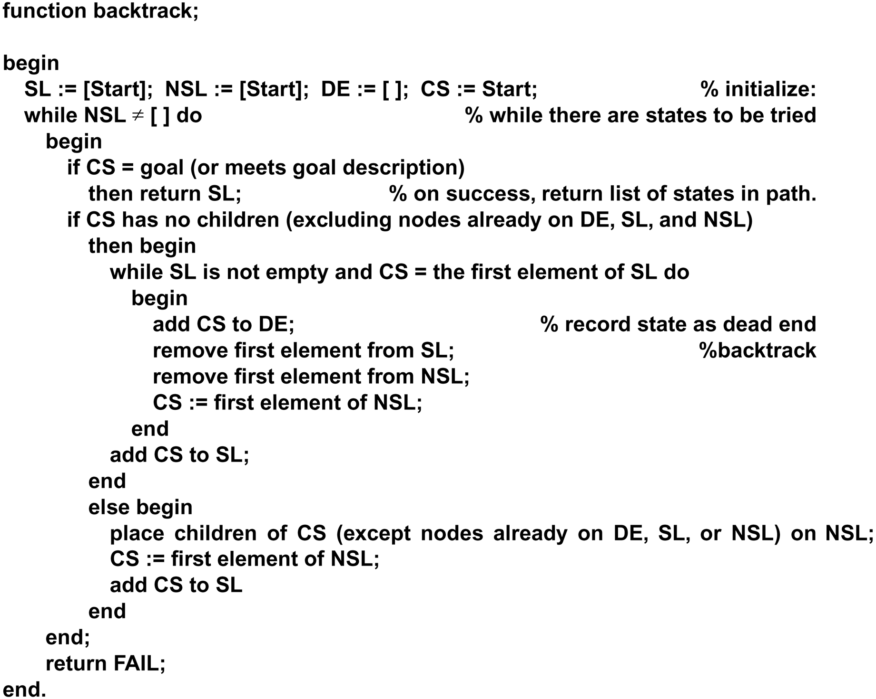
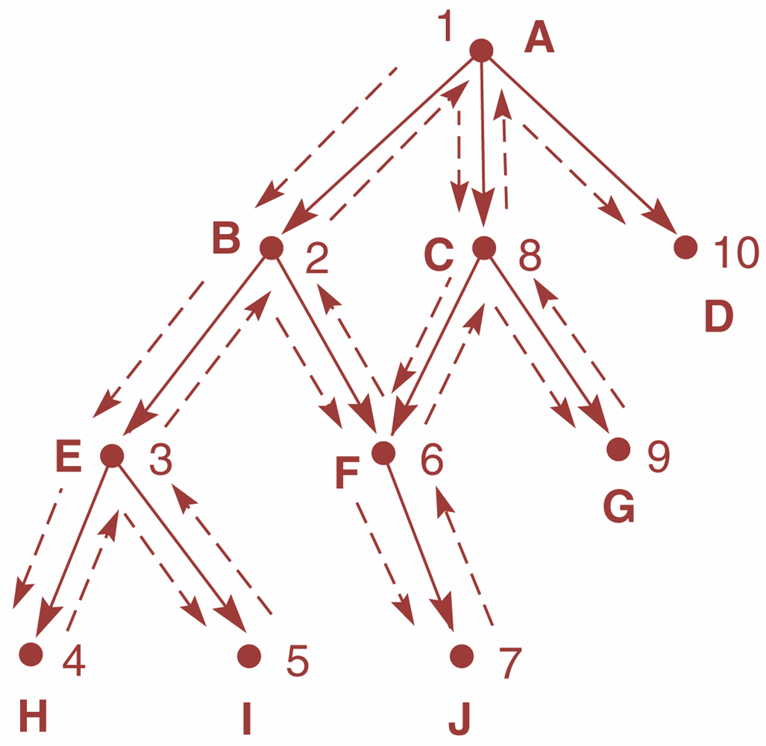
Implementation of Graph Search

Slide 34
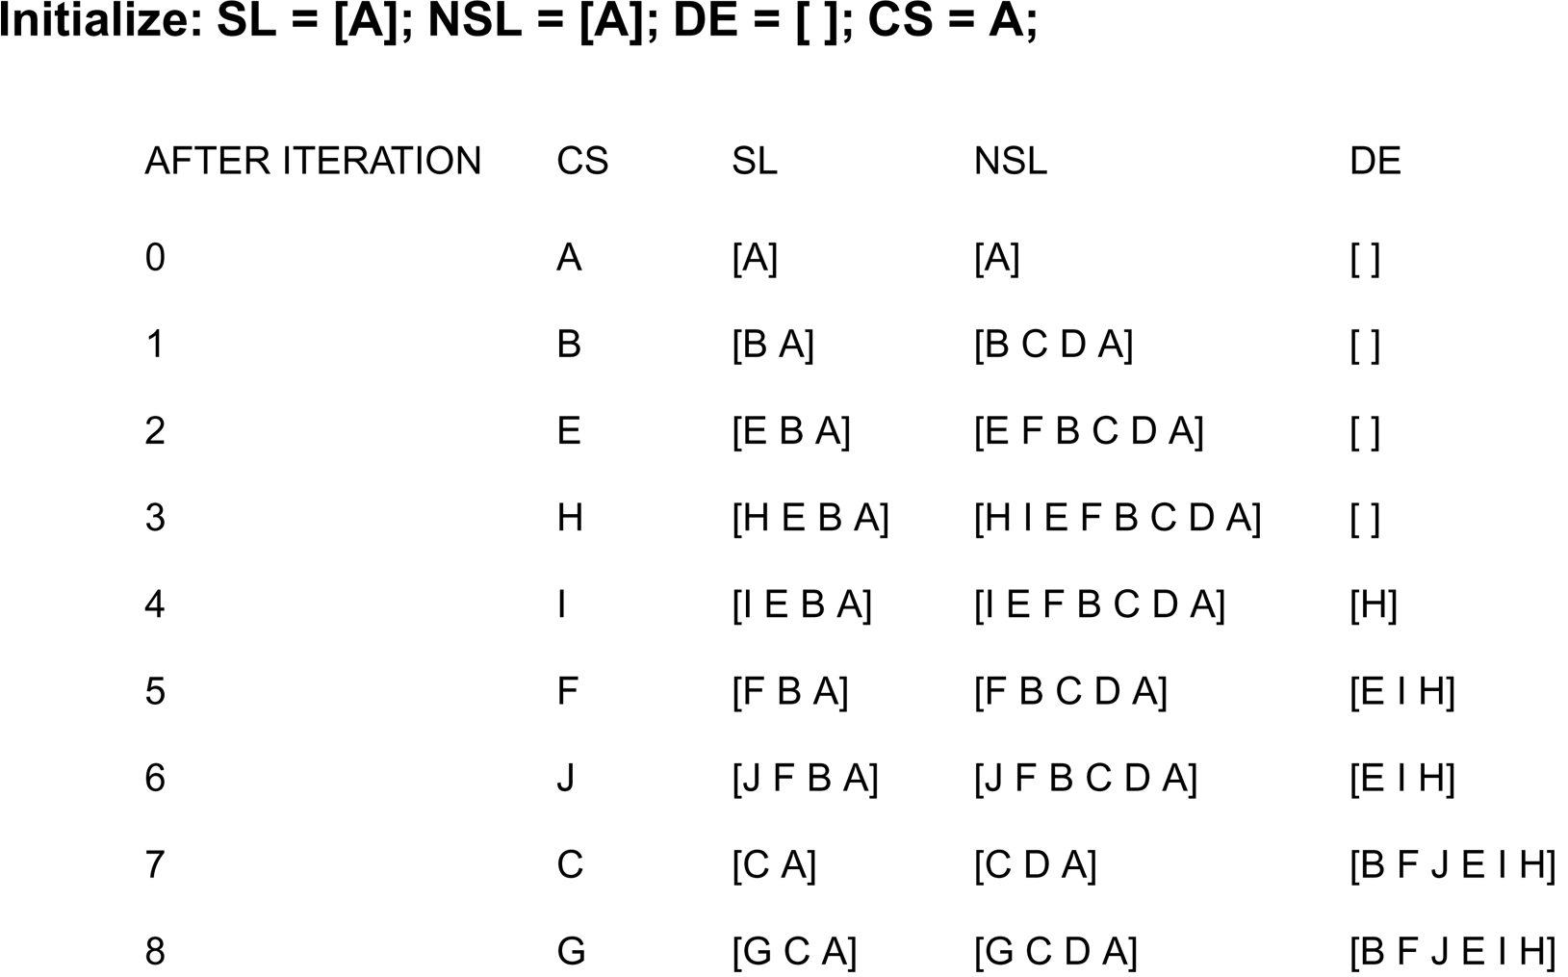
Implementation of Graph Search
Backtracking search of a hypothetical state space.
Current node
Node to visit
Goal

Slide 35
Implementation of Graph Search
Depth-First and Breadth-First Search
In addition to specifying a search direction (data-driven or goal- driven), a search algorithm must determine the order in which states are examined in the tree or the graph.
We will considers two possibilities for the order in which the nodes of the graph are considered:-
Depth-first search
Breadth-first search
Depth-first search, when a state is examined, all of its children and their descendants are examined before any of its siblings.
Depth-first search goes deeper into the search space whenever this is possible. Only when no further descendants of a state can be found are its siblings considered.
Depth-first search examines the states in the graph of Figure, in the order A, B, E, K, S, L, T, F, M, C, G, N, H, O, P, U, D, I, Q, J, R.
This search can be implemented with backtrack algorithm.

Slide 36
Implementation of Graph Search
Depth-First and Breadth-First Search
Breadth-first search, in contrast, explores the space in a level- by-level fashion.
Only when there are no more states to be explored at a given level does the algorithm move on to the next level.
A breadth-first search of the graph of Figure considers the states in the order A, B, C, D, E, F, G, H, I, J, K, L, M, N, O, P, Q, R, S, T, U.
We implement breadth-first search using lists, open and closed, to keep track of progress through the state space. Open, like NSL in backtrack, lists the states that have been generated but whose children have not been examined. The order in which states are removed from open determines the order of the search.
Closed records states that have already been examined.

Slide 37
Activity 3
Question :
Give the possibilities path for Depth-first search and Breadth-first search
A
B
C
D
E
F
G
H
I
J
K
L
M
N
O
P
Q
R
S
T
U

Slide 38
Activity 3 - Answer
DFS results: ABEKSLTFMCGNHOPUDIQJR
BFS results: ABCDEFGHIJKLMNOPQRSTU

Slide 39
Evaluation Criteria
Completeness
Time Complexity
Space Complexity
Optimality

Slide 40
Evaluation Criteria
Completeness
Time complexity
Evaluation Criteria
Space complexity
Search cost
Optimality
Path cost

Slide 41
Evaluation Criteria
completeness
if there is a solution, will it be found
time complexity
how long does it take to find the solution
does not include the time to perform actions
space complexity
memory required for the search
optimality
will the best solution be found
main factors for complexity considerations:
branching factor b, depth d of the shallowest goal node, maximum path length, m
Time and space complexity are measured in terms of b, d, m

Slide 42
Search and Path Cost
The search cost indicates how expensive it is to generate a solution
Time complexity (e.g. number of nodes generated) is usually the main factor
Sometimes space complexity (memory usage) is considered as well
Path cost indicates how expensive it is to execute the solution found in the search
distinct from the search cost, but often related
Total cost is the sum of search and path costs

